Slide 1
Lecture 3
CS4146 Document Architectures
HTML with Cascading Style Sheets (CSS)
Some slides are based on http://www.yourhtmlsource.com/

Slide 2
HTML and the World Wide Web
In 1991, Tim Berners-Lee (physicist at CERN) proposed an Internet-based hypertext system for using and sharing documents at the CERN physics laboratory.
  Hypertext: text document which contains links (called hyperlinks) to other documents.
The World Wide Web (W3) project of Berners-Lee and collaborators consisted of:
  Hyper-Text Markup Language (HTML) – SGML application
  Hyper-Text Transfer Protocol (HTTP)
  Concept of URL (Uniform Resource Locator)
Web Page – a text file with HTML markup, i.e. an HTML file, also called HTML document.

Slide 3


HTTP Protocol
HTTP Request
HTTP Response [+resource]
Web Browser
Web Server
Resource: Web page (i.e. HTML file), xml, image, video, audio, flash, etc.

Slide 4
URL: Uniform Resource Locator
http://www.w3.org/TR/html4/
scheme
server
path
URL: The official register of schemes (such as http, ftp, file, mailto, imap, https, etc.) is maintained by The Internet Assigned Numbers Authority (IANA).
Two types of URL: absolute and relative
  A relative URL is used to specify a URL that should be resolved relatively to a base URL.
  For example, the relative URL sgml/dtd.html inside an HTML document at the address http://www.w3.org/TR/html4/, is resolved to mean the absolute URL http://www.w3.org/TR/html4/sgml/dtd.html

Slide 5
Structure of an HTML File
<!DOCTYPE HTML PUBLIC "-//W3C//DTD HTML 4.01//EN" "http://www.w3.org/TR/html4/strict.dtd">
<html>
<head>
<title>
Very simple HTML document
</title>
</head>
<body>
<p class="normal_text">Hello World</p>
</body>
</html>
HTML version
and flavour
Head
Element
Body
Element
Attribute-Value Pair

Slide 6
Tree Representation
html
(root element)
head
body
title
p
text node
Very simple HTML document
text node
Hello World
attribute node
class:normal_text

Slide 7
HTML Element Format
<somename attributes>…</somename>
Opening Tag
Content: Could be either empty
or text
or elements
or mixture of text and elements
Closing Tag
If there is no content the opening and closing tags can be combined, e.g.
<br />
<img src="images/myphoto.jpg" />

Slide 8
Basic HTML Syntactic Rules
All elements must be nested properly (similar to nested loops in programming languages, for example).
HTML is not case sensitive, i.e. the case of the characters in element and attribute names does not matter.
Good style:
  Always have the root element html.
  Each element should have both an opening and a closing tag.
  Attribute values should be in quotes (either single or double).

Slide 9
Structural HTML Elements
HTML markup can define
  the structure (or logic) of the document.
  the presentation of the document, i.e. how it should be rendered.
It is recommended to use only structural markup in your web pages and describe the presentation separately in CSS style sheets.

Slide 10
Structural HTML Elements
<p>
  Defines a paragraph.
<h1>–<h6>
  Define headings. They should flow sequentially.
  The title of the page should always appear as a level 1 heading, with subheadings cascading down from it.
  Text is usually displayed in a large, bold font.

Slide 11
Structural HTML Elements (contd.)
<br>
  Line break.
<img>
  Used for embedding an externally stored image.
<div>
  Defines a division or a section in an HTML document.

Slide 12
Structural HTML Elements (contd.)
<a>
  Defines an anchor which cab be used:
    To create a link to another document, by using the href attribute.
    To create a bookmark inside a document, by using the name attribute.
  Example: <a href="http://www.ul.ie">Click here</a>
<code> is suitable for giving examples of computer code, and is usually rendered in a mono-spaced font. Equivalent to <tt>.
<pre>
  defines preformatted text, i.e. all white space is preserved as it is in the HTML file.

Slide 13
Structural HTML Elements (contd.)
<em> creates emphasis, and is usually displayed as italicised text. Equivalent to <i>.
<strong> creates strong emphasis, and is usually displayed as bold text. Equivalent to <b>.
<span>
  Define a span of text without default visual effect.

Slide 14
Structural HTML Elements (contd.)
<blockquote> used to enclose multi-line quotations from other sources. It is usually displayed as indented from both sides.
<ul> defines an unordered list (i.e. a bulleted list).
  Example:
  <ul>
  <li>Monday</li>
  <li>Tuesday</li>
  <li>Wednesday</li>
  </ul>
<ol> defines an ordered list.
  Example:
  <ol>
  <li>Monday</li>
  <li>Tuesday</li>
  <li>Wednesday</li>
  </ol>
Monday
Tuesday
Wednesday
Monday
Tuesday
Wednesday

Slide 15
HTML Tables
Date | Students
 | LM113 | LM114
10 February | 10 | 20
20 February | 30 | 10
10 March | 10 | 40
<table>
<thead>
<tr>
<th rowspan="2">Date</th>
<th colspan="2">Students</th>
</tr>
<tr><th>LM113</th><th>LM114</th></tr>
</thead>
<tbody>
<tr><td>10 February</td><td>10</td><td>20</td></tr>
<tr><td>20 February</td><td>30</td><td>10</td></tr>
<tr><td>10 March</td><td>10</td><td>40</td></tr>
</tbody>
</table>

Slide 16
HTML Forms
Form container:
<form name="somename" method="post" action="URL">
<!-- Form elements will go in here -->
</form>
Form elements:
  Text boxes
  Selection boxes
  Send and reset buttons
Based on http://www.yourhtmlsource.com/forms/basicforms.html

Slide 17
HTML Forms: Text boxes
  One-line text box
  <input type="text" name="tb1" size="25">
  Text area box
  <textarea name="tb2" cols="50" rows="4">
  </textarea>
Based on http://www.yourhtmlsource.com/forms/basicforms.html

Slide 18
HTML Forms: Text boxes
(Full Example)
<body>
<form name="somename" method="post" action="">
<p>
Subject:<br>
<input type="text" name="tb1" size="25">
</p>
<p>
Description:<br>
<textarea name="tb2" rows="4" cols="50">
</textarea>
</p>
</form>
</body>
Based on http://www.yourhtmlsource.com/forms/basicforms.html

Slide 19
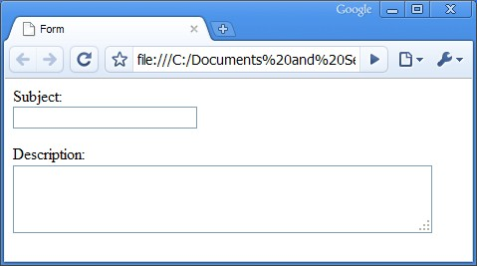
HTML Forms: Text boxes
(Full Example contd.)
Based on http://www.yourhtmlsource.com/forms/basicforms.html

Slide 20
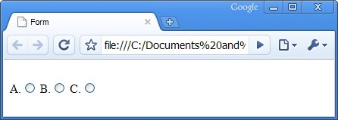
HTML Forms: Selection Boxes
Radio buttons:
A.<input type="radio" name="question" value="ans1">
B.<input type="radio" name="question" value="ans2">
C.<input type="radio" name="question" value="ans3">
Based on http://www.yourhtmlsource.com/forms/basicforms.html

Slide 21
HTML Forms: Selection Boxes (contd.)
Check buttons:
<input type="checkbox" name="somename">
Check button which is checked by default:
<input type="checkbox" name="newsletter" checked="checked">
Based on http://www.yourhtmlsource.com/forms/basicforms.html

Slide 22
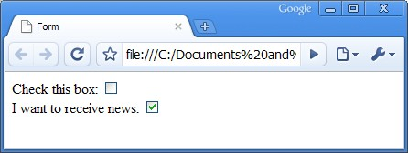
HTML Forms: Selection Boxes (contd.)
Check buttons (full example):
<body>
<form name="somename" method="post" action="">
Check this box:
<input type="checkbox" name="somename"><br>
I want to receive news:
<input type="checkbox" name="newsletter"
checked="checked">
</form>
</body>
Based on http://www.yourhtmlsource.com/forms/basicforms.html

Slide 23
HTML Forms: Selection Boxes (contd.)
Drop-down select boxes
<select name="continent" size="1">
<option value="europe">europe</option>
<option value="namerica">n. america</option>
<option value="samerica">s. america</option>
<option value="asia">asia</option>
<option value="africa">africa</option>
<option value="oz">the other one</option>
</select>
Based on http://www.yourhtmlsource.com/forms/basicforms.html

Slide 24
HTML Forms: Submit and Reset Buttons
<input type="submit" value="Submit">
<input type="reset">
Based on http://www.yourhtmlsource.com/forms/basicforms.html

Slide 25
HTML Forms: The method Attribute
Specifies the HTTP method for sending data to the action URL. Default is get.
method="get": This method sends the form contents in the URL: URL?name=value&name=value.
  Note: If the form values contains non-ASCII characters or exceeds 100 characters you MUST use method="post".
method="post": This method sends the form contents in the body of the request.

Slide 26
Block-Level vs. Inline Elements
Block-level elements are used to format whole blocks of text:
  they stand out on their own, spanning the available screen-width and usually adding line breaks before and after themselves.
  can contain other block-level elements and inline elements.
  Examples: blockquote, div, h1-h6, p, pre, ul, ol, li.
Inline elements can be introduced along the normal flow of text and can be used to affect single characters.
  Examples: a, em, span, strong

Slide 27
Cascading Style Sheets (CSS)
A style-sheet language introduced by W3C in 1996 to be used for adding style to Web documents (including HTML files).
Current version - CSS 2.
  CSS 3 under development.
Why cascading?
  Refers to the way style-sheet rules override each other.
  We will discuss this later.

Slide 28
CSS Syntax
A style sheet is a flat list of rules.
Each rule (or style) has the following syntax:
selector {
property: value;
property: value; …
}
Selector is
  Name of an HTML element.
  Comma-separated list of names of HTML elements.
  .classname which can be applied to any element with attribute class="classname"
  #idnumber which can be applied to any element with attribute id="idnumber"
  A few more advanced options.

Slide 29
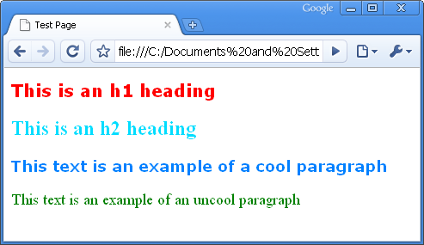
Example 1
<!DOCTYPE HTML PUBLIC "-//W3C//DTD HTML 4.01//EN" "http://www.w3.org/TR/html4/strict.dtd">
<html>
<head>
<title>Test Page</title>
<link rel="stylesheet" type="text/css" href="somestyles.css">
</head>
<body>
<h1>This is an h1 heading</h1>
<h2>This is an h2 heading</h2>
<p class="cool">This text is an example of a cool paragraph</p>
<p>This text is an example of an uncool paragraph</p>
</body>
</html>
styles-ex1.html
p {color: green; font-size: large;}
h1 {font-family: Verdana, sans-serif; color: red; font-size: 20px;}
h2, h3 {color: #00DDFF; width: 80%;}
.cool {font-family: Verdana; color: #0080FF; font-weight: bold; }
somestyles.css

Slide 30
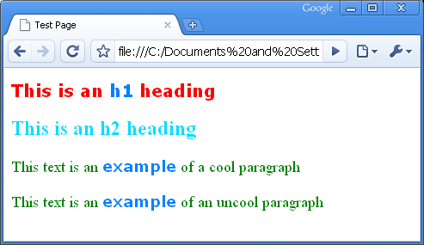
Example 2
<!DOCTYPE HTML PUBLIC "-//W3C//DTD HTML 4.01//EN" "http://www.w3.org/TR/html4/strict.dtd">
<html>
<head>
<title>Test Page</title>
<link rel="stylesheet" type="text/css" href="somestyles.css">
</head>
<body>
<h1>This is an <span class="cool">h1</span> heading</h1>
<h2>This is an h2 heading</h2>
<p>This text is an <span class="cool">example</span> of a cool paragraph</p>
<p>This text is an <span class="cool">example</span> of an uncool paragraph</p>
</body>
</html>
styles-ex2.html
p {color: green; font-size: large;}
h1 {font-family: Verdana, sans-serif; color: red; font-size: 20px;}
h2, h3 {color: #00DDFF; width: 80%;}
.cool {font-family: Verdana; color: #0080FF; font-weight: bold; }
somestyles.css

Slide 31
Including CSS in HTML Files
Option 1: Save your rules into a separate style-sheet file and have your pages referencing it.
Option 2: Integrate CSS rules directly into the head element of each of your HTML files.
Option 3: Integrate CSS code directly into the opening tag of an HTML element.

Slide 32
Option 1: Linked Style Sheets
Create a text file, e.g. mystyle.css.
Tell your HTML file where the style sheet is by including a link element into the head element.
Example:
<link rel="stylesheet" type="text/css" href="mystyle.css"/>

Slide 33
Option 1: Imported Style Sheets
You can also import .css files:
Example:
<style type="text/css" media="all">
@import "style1.css";
@import "style2.css";
</style>
Importing style sheets does not work with some old versions of the Web browser.

Slide 34
Option 2: Style Block
Place CSS rules into a style element which goes into the head element of an HTML file.
Example:
<style type="text/css">
p {font-weight: normal; color: gray;}
h1 {color: black;}
</style>

Slide 35
Option 3: Style Attribute
To define style for one element only, you can embed style information into it using the style attribute.
Every non-presentational HTML element can have a style attribute.
Example:
<p style="color: blue; font-family: Arial;">

Slide 36
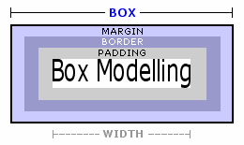
The CSS Box Model
All HTML block-level elements have five spacing properties: height, width, margin, border and padding.
Caution: IE5 does not make the correct interpretation
of the box model properties!
Image Source: http://www.yourhtmlsource.com/stylesheets/media/boxmodelling.gif

Slide 37
The CSS Box Model (contd.)
Examples:
  p {width: 600px; padding: 5px; }
  blockquote {margin: 20px; }
  p { margin-left: 2px;
  margin-top: 80px;
  margin-right: 45px;
  margin-bottom: -5px; }
  div {margin: 20px 0px 100px 10px; }
  body {margin: 0px; padding: 0px; }
Negative values
make things overlap

